Slide 1
Agenda:
A few machine learning examples
Work on projects

Slide 2
Reasons to try Machine Learning
If you liked 351, consider Machine Learning
Full of mathematical “tricks” and derivations
Increased demand for ML/ competitive Salaries
The applications are used to save lives
Autonomous helicopters fly up-side-down by apprentice learning

Slide 3


Slide 4
Definition of Machine Learning
Machine Learning: A branch of Artificial Intelligence regarding computer programs that change when exposed to new data.
Usually when the algorithm obtains new information, it is able to make a better educated guess.

Slide 5
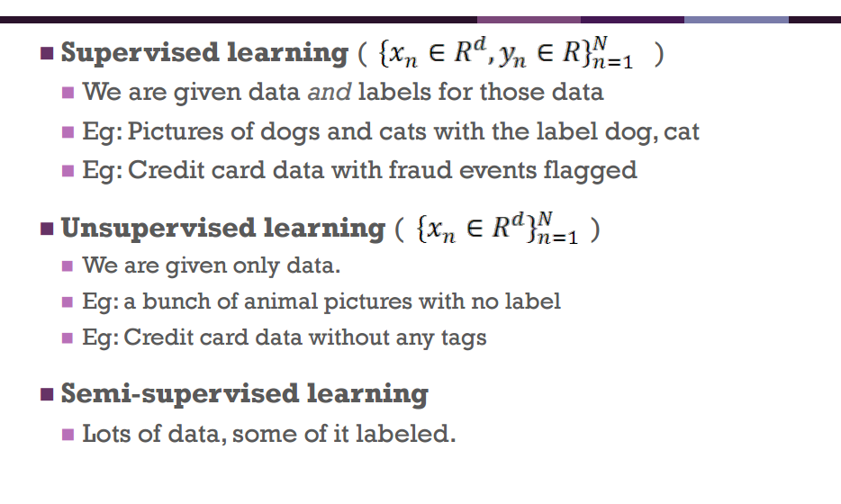
Supervised vs. Unsupervised Learning

Slide 6
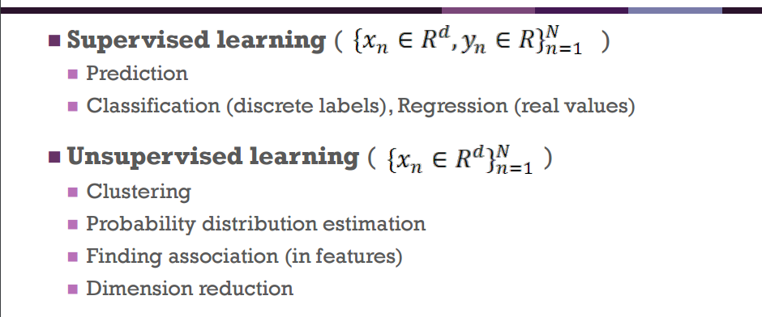
Examples

Slide 7
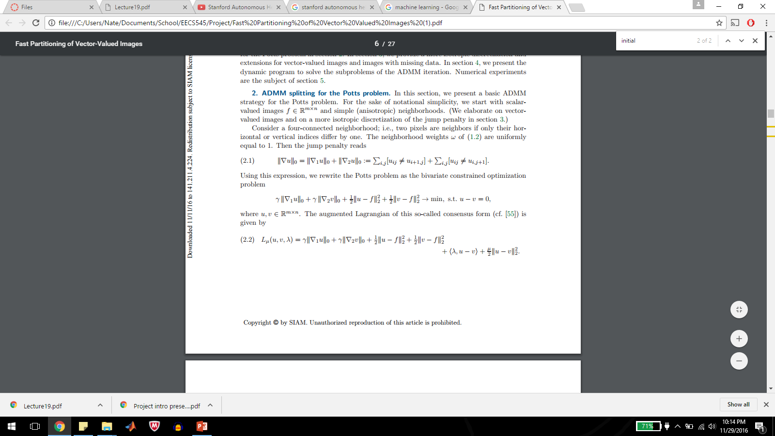
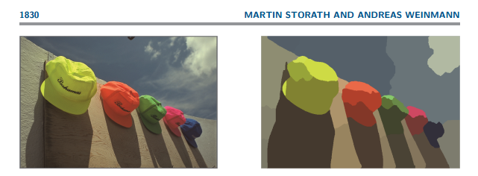
What is Nate Working On?
Image Segmentation! (unsupervised)

Slide 8
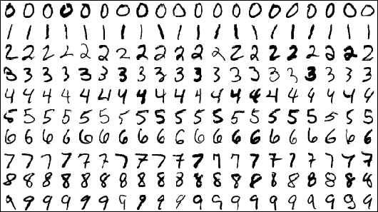
K-Nearest Neighbor
With Machine Learning, you can EASILY build a digit recognition system. One of the simplest methods in the universe is called K-nearest Neighbor (KNN).
Choose the class corresponding to the k most similar training examples

Slide 9
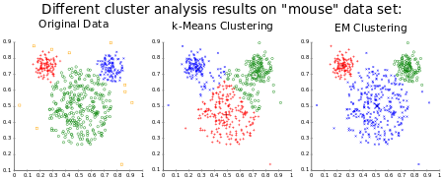
K-Means
Goal is to choose K clusters that minimize in class scatter

Slide 10
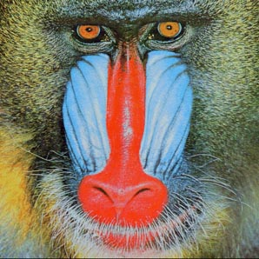
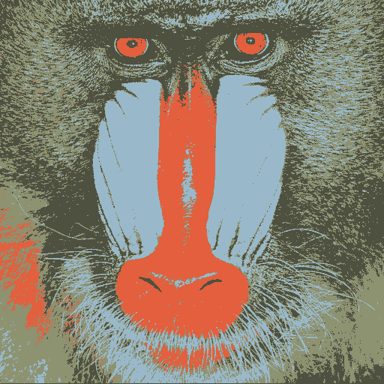
K-means Image compression
In image processing, assume the picture can be represented by k colors. K-means finds the K colors that sub-optimally represent the picture.

Slide 11
K-means Image compression
Compression ratios for K-means compression can be around 90% with only ~10% error.

Slide 12
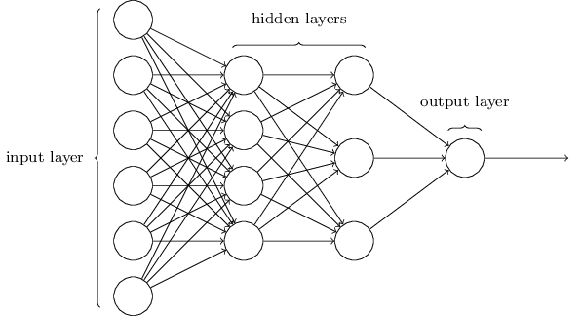
Neural Network
Neural Nets are often used to minimize a cost function
Neural Nets often use back-propogation: look at the final output, see what previous weights need to be to make the error function lower

Slide 13
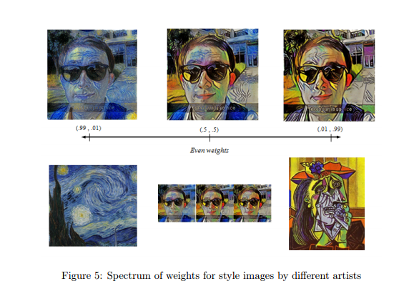
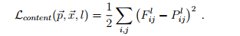
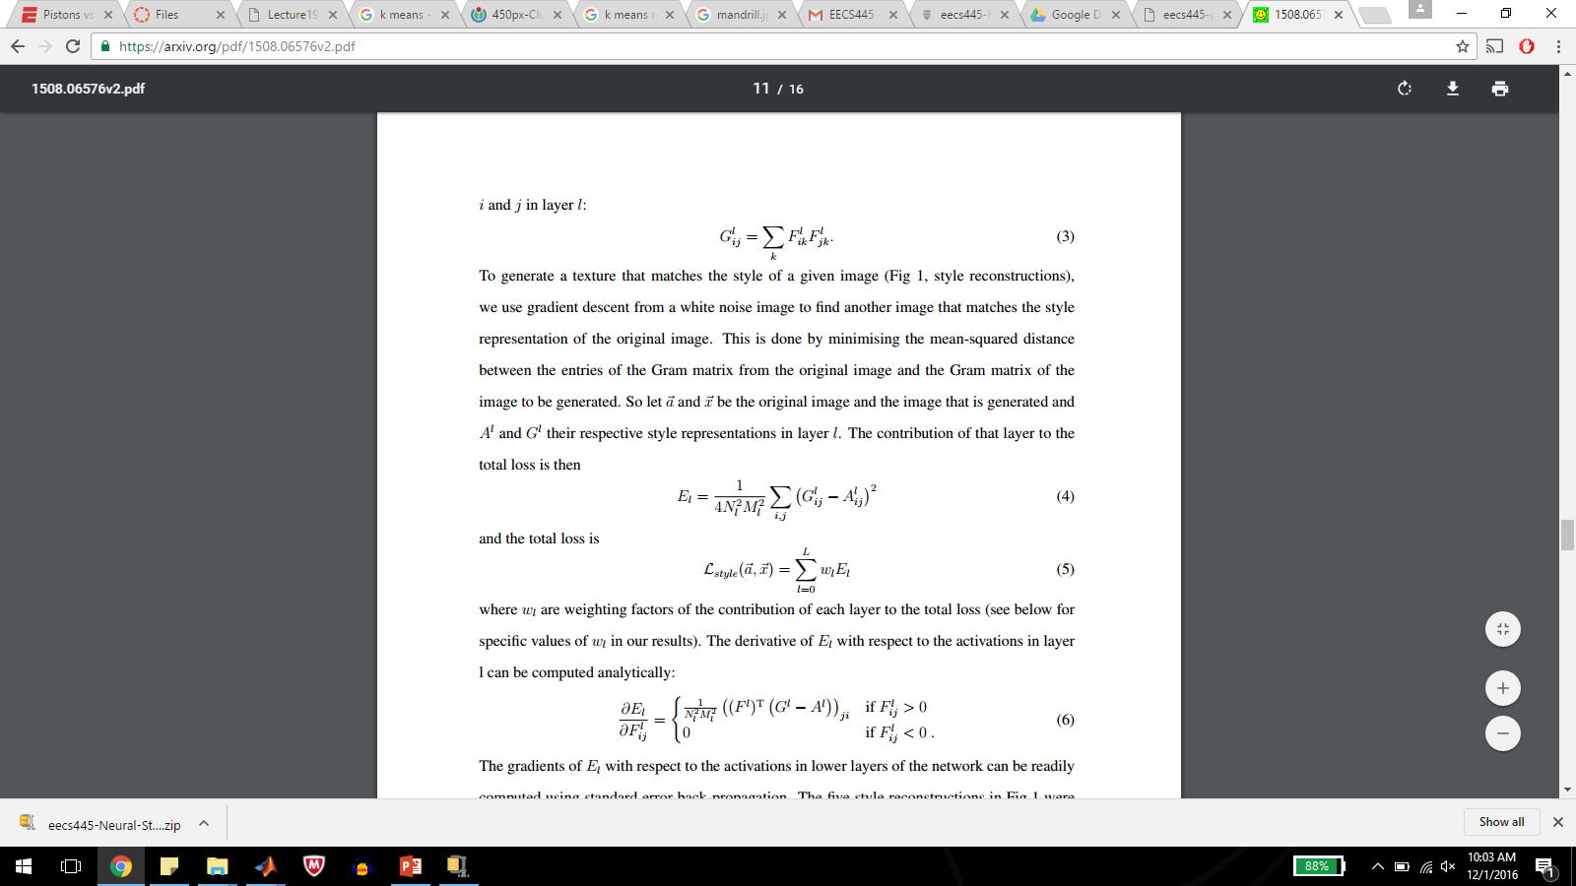
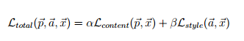
Nate’s 445 Project – Convolutional Neural Network

Slide 14
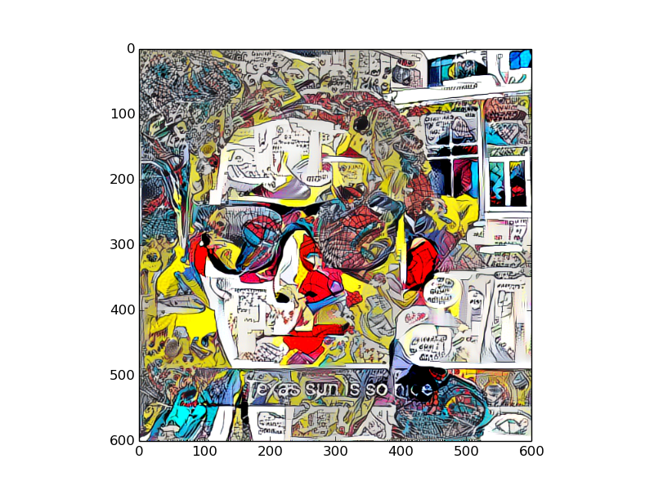
Spiderman Style Image

Slide 15
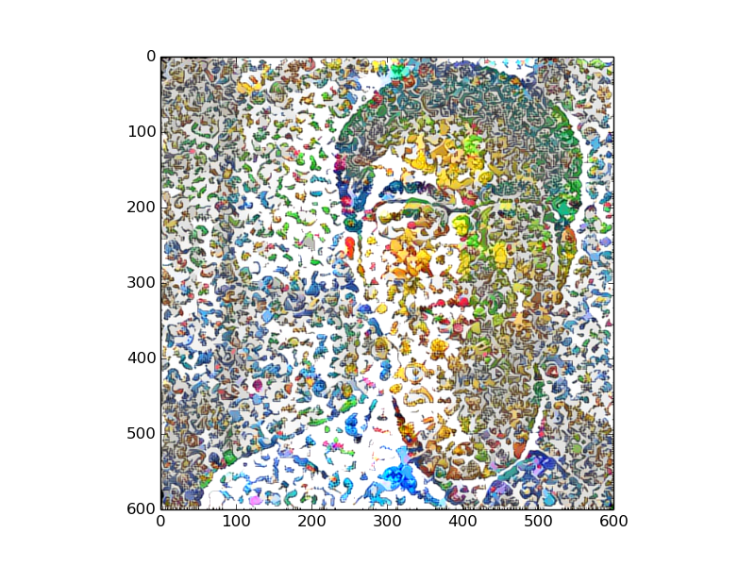
Pokemon Style Image

